Slide 1




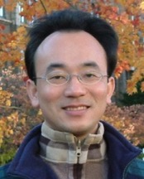



NTCIR Evaluation of Dialogue System and Financial Technology
Host: 吳怡瑾 教授 (Prof. Nancy I-Chin Wu) Graduate Institute of Library & Information Studies, National Taiwan Normal University (NTNU)
Time: 13:30-15:30, September 16, 2022 (Friday)
Place: Graduate Institute of Library & Information Studies, NTNU
戴敏育 副教授
Min-Yuh Day, Ph.D, Associate Professor
國立臺北大學 資訊管理研究所
Institute of Information Management, National Taipei University
https://web.ntpu.edu.tw/~myday
2022-09-16

Slide 2










戴敏育 博士 (Min-Yuh Day, Ph.D.)
1
國立臺北大學 資訊管理研究所 副教授
中央研究院 資訊科學研究所 訪問學人
國立臺灣大學 資訊管理 博士
Publications Co-Chairs, IEEE/ACM International Conference on Advances in Social Networks Analysis and Mining (ASONAM 2013- )
Program Co-Chair, IEEE International Workshop on Empirical Methods for Recognizing Inference in TExt (IEEE EM-RITE 2012- )
Publications Chair, The IEEE International Conference on Information Reuse and Integration for Data Science (IEEE IRI)

Slide 3
Outline
NTCIR Evaluation of Information Access Technologies
NTCIR 16 (2021-2022)
NTCIR 17 (2022-2023)
Dialogue System
Financial Technology

Slide 4
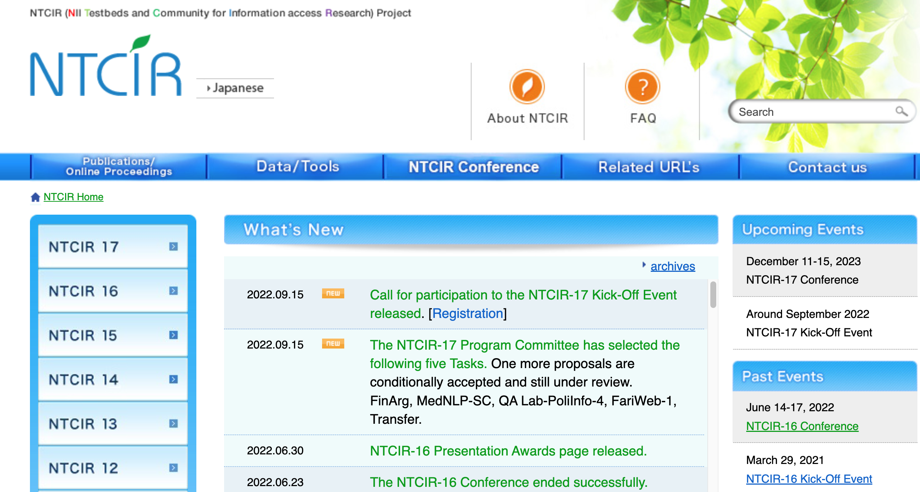
NTCIR
http://research.nii.ac.jp/ntcir/index-en.html
Source: http://research.nii.ac.jp/ntcir/index-en.html

Slide 5

Why NTCIR Evaluation Forum?
Can develop a large-scale test collections
Can fairly compare the systems
Can communicate with people who has the same research interest
NII Testbeds and Community for Information access Research
Source: Takehiro Yamamoto and Zhicheng Dou (2022), Overview of NTCIR-16, NTCIR-16 Proceedings

Slide 6
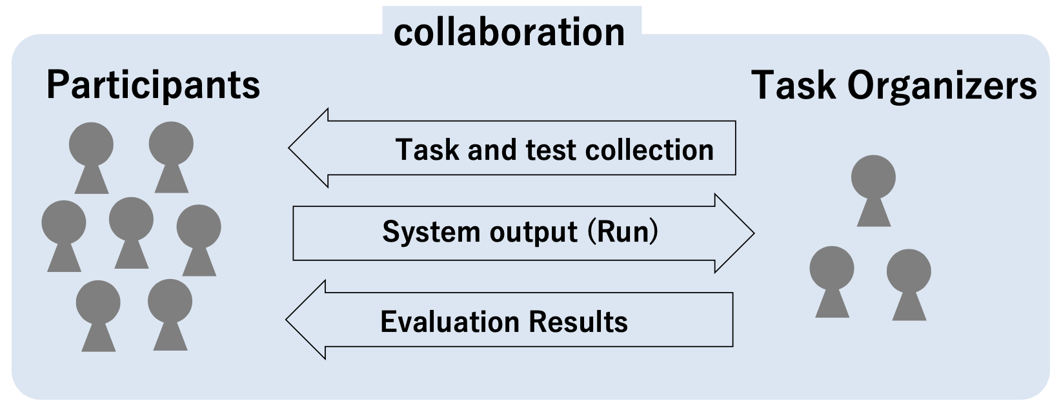
NTCIR Evaluation Forum
Research groups gather together and tackle the same problems (problem definition, test collection, evaluation measure, etc.)
The systems can be compared across participants
Share results, exchange ideas
Source: Takehiro Yamamoto and Zhicheng Dou (2022), Overview of NTCIR-16, NTCIR-16 Proceedings

Slide 7
History of NTCIR Tasks
Year | 1999 | 2001 | 2002 | 2004 | 2005 | 2007 | 2008 | 2010 | 2011 | 2013 | 2014 | 2016 | 2017 | 2019 | 2020 | 2022
Task/NTCIR round | 1 | 2 | 3 | 4 | 5 | 6 | 7 | 8 | 9 | 10 | 11 | 12 | 13 | 14 | 15 | 16
Total number | 37 | 39 | 61 | 74 | 79 | 81 | 80 | 66 | 102 | 108 | 93 | 97 | 71 | 47 | 52 | 53
Automatic Term Recognition and Role Analysis (TMREC) (1) | 9
Ad hoc/Crosslingual IR (1) -> Chinese/English/Japanese IR (2) -> CLIR (3-6) | 28 | 30 | 20 | 26 | 25 | 22
Text Summarization Challenge (TSC) (2-4) |  | 9 | 8 | 9
Web Retrieval (WEB) (3-5) |  |  | 7 | 11 | 7
Question Answering Challenge (QAC) (3-6) |  |  | 16 | 18 | 7 | 8
Patent Retrieval [and Classification] (PATENT) (3-6) |  |  | 10 | 10 | 13 | 12
Multimodal Summarization for Trend Information (MUST) (5-7) |  |  |  |  | 13 | 15 | 13
Crosslingual Question Answering (CLQA) (5, 6) -> Advanced Crosslingual Information Access (ACLIA) (7, 8) |  |  |  |  | 14 | 12 | 19 | 14
Opinion (6) -> Multilingual Opinion Analysis (MOAT) (7, 8) |  |  |  |  |  | 12 | 21 | 16
Patent Mining (PAT-MN) (7, 8) |  |  |  |  |  |  | 12 | 11
Community Question Answering (CQA) (8) |  |  |  |  |  |  |  | 4
Geotemporal IR (GeoTime) (8, 9) |  |  |  |  |  |  |  | 13 | 12
Interactive Visual Exploration (Vis-Ex) (9) |  |  |  |  |  |  |  |  | 4
Patent Translation (PAT-MT)(7, 8) -> Patent Machine Translation (PatentMT)(9, 10) |  |  |  |  |  |  | 15 | 8 | 21 | 21
Crosslingual Link Discovery (Crosslink) (9, 10) |  |  |  |  |  |  |  |  | 11 | 10
INTENT(9, 10) -> Search Intent and Task Mining (IMine) (11, 12) |  |  |  |  |  |  |  |  | 16 | 11 | 12 | 9
One Click Access (1CLICK)(9, 10) -> Mobile Information Access (MobileClick) (11, 12) |  |  |  |  |  |  |  |  | 4 | 8 | 4 | 11
Recognizing Inference in Text (RITE)(9,10) -> Recognizing Inference in Text and Validation (RITE-VAL)(11) |  |  |  |  |  |  |  |  | 24 | 28 | 23
IR for Spoken Documents (SpokenDoc) (9, 10) -> Spoken Query and Spoken Document Retrieval (SpokenQuery&Doc) (11, 12) |  |  |  |  |  |  |  |  | 10 | 12 | 11 | 7
Mathematical Information Access (Math) (10, 11) -> MathIR (12) |  |  |  |  |  |  |  |  |  | 6 | 8 | 6
Medical Natural Language Processing (MedNLP) (10, 11) -> MedNLPDoc (12) -> MedWeb (13) –> Real-MedNLP(16) |  |  |  |  |  |  |  |  |  | 12 | 12 | 8 |  | 9 |  | 10
QA Lab for Entrance Exam (QALab) (11, 12, 13) -> QA Lab for Political Information (QALab-PoliInfo) (14, 15, 16) |  |  |  |  |  |  |  |  |  |  | 11 | 12 | 11 | 13 | 14 | 12
Temporal Information Access (Temporalia) (11, 12) |  |  |  |  |  |  |  |  |  |  | 8 | 14
Cooking Recipe Search (RecipeSearch) (11) |  |  |  |  |  |  |  |  |  |  | 4
Personal Lifelog Organisation & Retrieval (Lifelog) (12, 13, 14, 16) |  |  |  |  |  |  |  |  |  |  |  | 8 | 4 | 6 |  | 3
Short Text Conversation (STC) (12, 13, 14) |  |  |  |  |  |  |  |  |  |  |  | 22 | 27 | 13
Open Live Test for Question Retrieval (OpenLiveQ) (13, 14) |  |  |  |  |  |  |  |  |  |  |  |  | 7 | 4
Actionable Knowledge Graph (AKG) (13) |  |  |  |  |  |  |  |  |  |  |  |  | 3
Emotion Cause Analysis (ECA) (13) |  |  |  |  |  |  |  |  |  |  |  |  | 3
Neurally Augmented Image Labelling Strategies (NAILS) (13) |  |  |  |  |  |  |  |  |  |  |  |  | 2
We Want Web (WWW) (13, 14) -> We Want Web with CENTER (WWW) (15, 16) |  |  |  |  |  |  |  |  |  |  |  |  | 5 | 4 | 8 | 3
Fine-Grained Numeral Understanding in Financial Tweet (FinNum) (14,15,16) |  |  |  |  |  |  |  |  |  |  |  |  |  | 6 | 7 | 7
CLEF/NTCIR/TREC REproducibility (CENTRE) (14) |  |  |  |  |  |  |  |  |  |  |  |  |  | 1
Dialogue Evaluation (DialEval) (15, 16) |  |  |  |  |  |  |  |  |  |  |  |  |  |  | 7 | 4
SHINRA 2020 Multi-lingual (SHINRA 2020-ML) (15) |  |  |  |  |  |  |  |  |  |  |  |  |  |  | 7
Data Search (Data Search) (15, 16) |  |  |  |  |  |  |  |  |  |  |  |  |  |  | 5 | 6
Micro Activity Retrieval Task (MART) (15) |  |  |  |  |  |  |  |  |  |  |  |  |  |  | 5
Session Search (SS) (16) |  |  |  |  |  |  |  |  |  |  |  |  |  |  |  | 3
Reading Comprehension for Information Retrieval (RCIR) (16) |  |  |  |  |  |  |  |  |  |  |  |  |  |  |  | 3
Unbiased Learning to Ranking Evaluation Task (ULTRE) (16) |  |  |  |  |  |  |  |  |  |  |  |  |  |  |  | 2
Source: Takehiro Yamamoto and Zhicheng Dou (2022), Overview of NTCIR-16, NTCIR-16 Proceedings

Slide 8
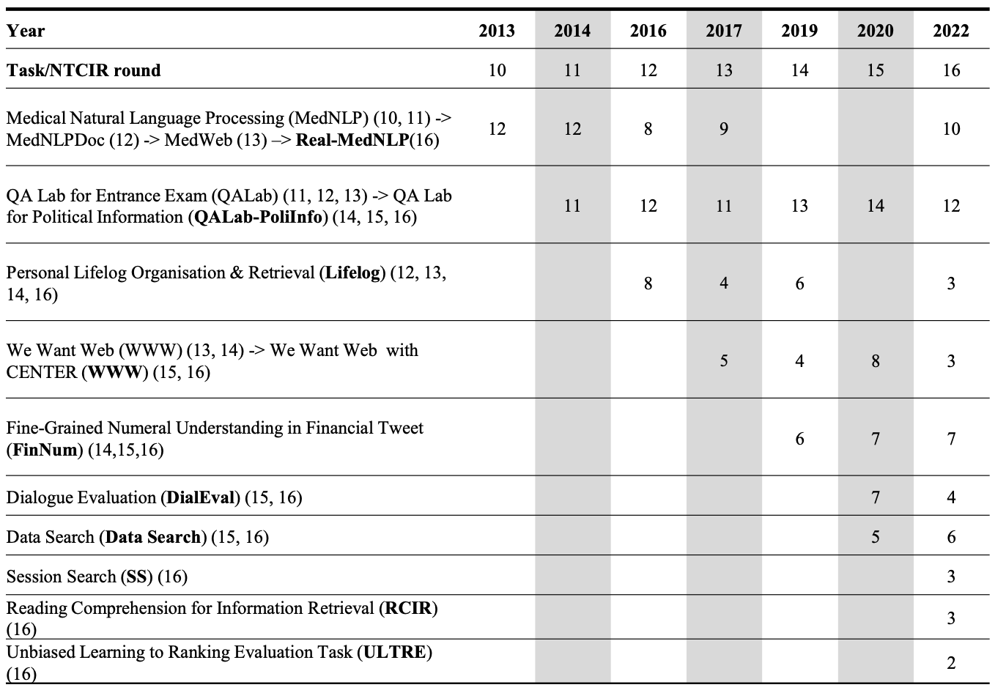
History of NTCIR-16 Tasks
Source: Takehiro Yamamoto and Zhicheng Dou (2022), Overview of NTCIR-16, NTCIR-16 Proceedings

Slide 9
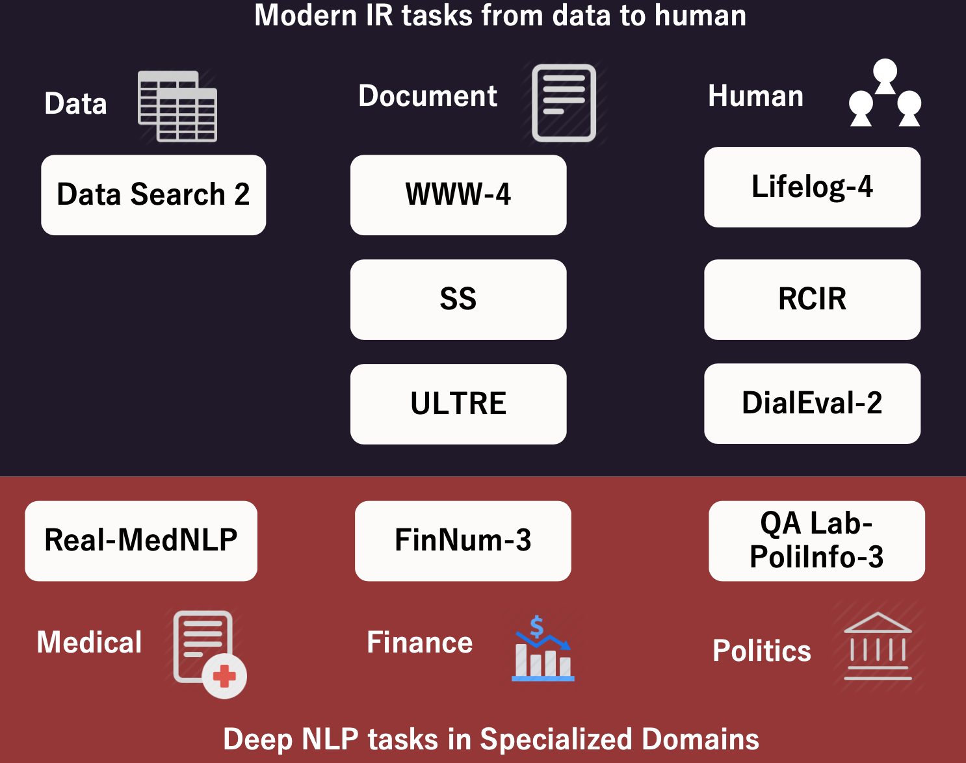
Information Retrieval + NLP
Source: Takehiro Yamamoto and Zhicheng Dou (2022), Overview of NTCIR-16, NTCIR-16 Proceedings

Slide 10
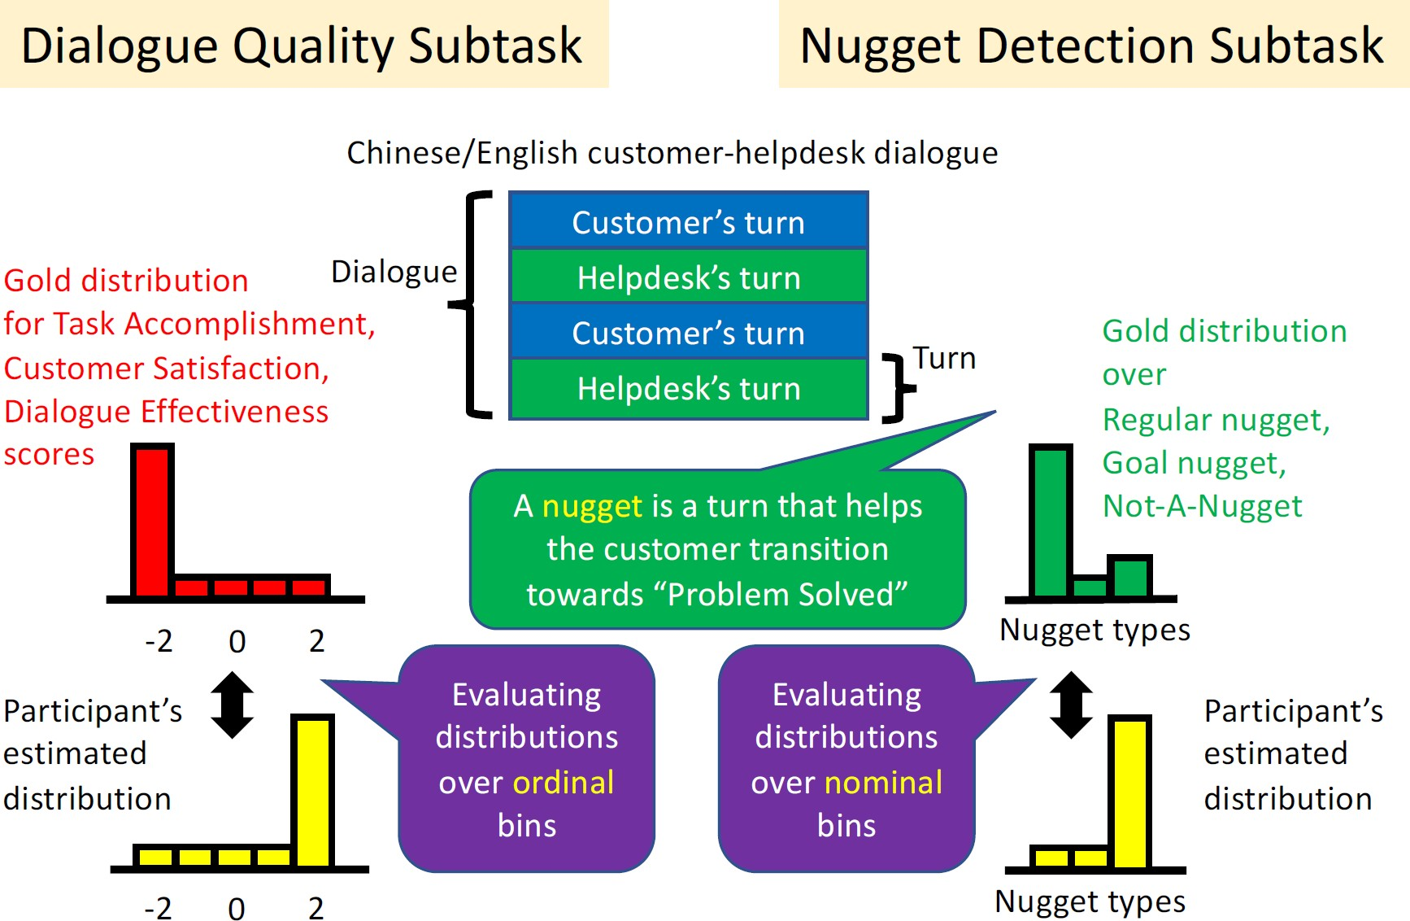
DialEval-2 (Dialogue Evaluation) Evaluation of the quality of a customer-helpdesk dialogue
Source: Takehiro Yamamoto and Zhicheng Dou (2022), Overview of NTCIR-16, NTCIR-16 Proceedings

Slide 11
FinNum-3 (Investor’s and Manager’s Fine-grained Claim Detection) Fine-grained understanding of claims in financial documents Investors always make a claim with an estimation
We estimate that the sales growth rate may exceed 80%
Detect the given numeral is in-claim or out-of-claim
Classify the category of the numeral
Documents: Investors reports, earnings conference calls
Source: Takehiro Yamamoto and Zhicheng Dou (2022), Overview of NTCIR-16, NTCIR-16 Proceedings

Slide 12
The 17th NTCIR (2022 - 2023) Evaluation of Information Access Technologies July 2022 - December 2023
CORE TASKS
Fine-grained Argument Understanding in Financial Analysis (FinArg)
Medial Natural Language Processing for Social media and Clinical texts (MedNLP-SC)
QA Lab for Political Information 4 (QA Lab-PoliInfo-4)
PILOT TASKS
The First Fair Web Task (FairWeb-1)
Resource Transfer Based Dense Retrieval (Transfer)
Source: https://research.nii.ac.jp/ntcir/ntcir-17/index.html

Slide 13
The 17th NTCIR (2022 - 2023) Evaluation of Information Access Technologies July 2022 - December 2023
Sep 2022 NTCIR-17 kickoff
Jan 2023 Dataset Release*
Jan-Jun, 2023 Dry Run*
Mar-Jul, 2023 Formal Run*
Aug 1, 2023 Evaluation result return
Aug 1, 2023 Task overview paper release (draft)
Sep 1, 2023 Submission due of participant papers (draft)
Nov 1, 2023 Camera-ready participant paper due
Dec 2023 NTCIR-17 Conference in NII, Tokyo
Source: https://research.nii.ac.jp/ntcir/ntcir-17/index.html

Slide 14



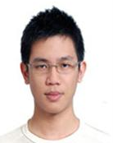
Tamkang University
2011
Tamkang University
IMTKU Textual Entailment System for Recognizing Inference in Text at NTCIR-9 RITE
Department of Information Management Tamkang University, Taiwan
Min-Yuh Day
Chun Tu
myday@mail.tku.edu.tw
NTCIR-9 Workshop, December 6-9, 2011, Tokyo, Japan

Slide 15
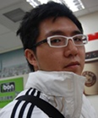
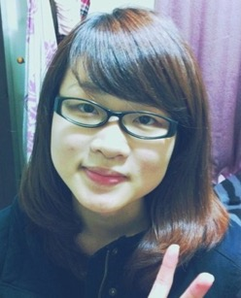
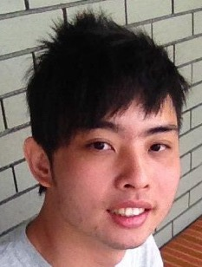
IMTKU Textual Entailment System for Recognizing Inference in Text at NTCIR-10 RITE-2
Tamkang University
2013
Tamkang University
Department of Information Management Tamkang University, Taiwan
Min-Yuh Day
Chun Tu
Hou-Cheng Vong
Shih-Wei Wu
Shih-Jhen Huang
myday@mail.tku.edu.tw
NTCIR-10 Conference, June 18-21, 2013, Tokyo, Japan

Slide 16

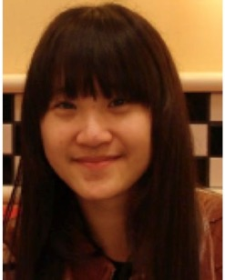
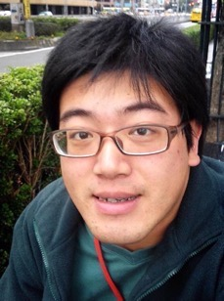
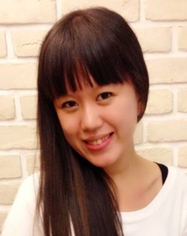
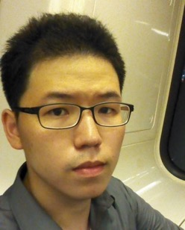
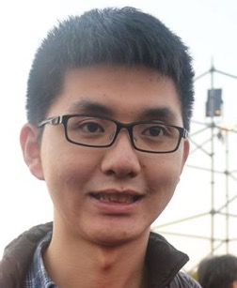
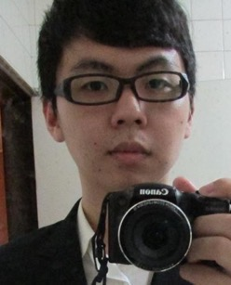
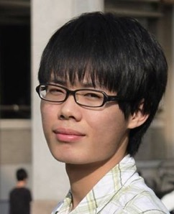
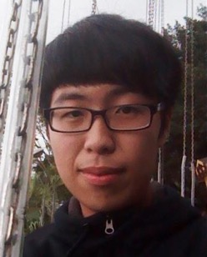
IMTKU Textual Entailment System for Recognizing Inference in Text at NTCIR-11 RITE-VAL 2014
Tamkang University
Min-Yuh Day
Ya-Jung Wang
Che-Wei Hsu
En-Chun Tu
Huai-Wen Hsu
Yu-An Lin
Shang-Yu Wu
Yu-Hsuan Tai
Cheng-Chia Tsai
NTCIR-11 Conference, December 8-12, 2014, Tokyo, Japan

Slide 17




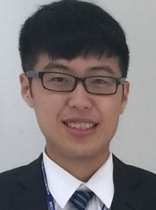
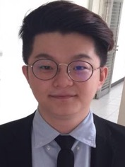
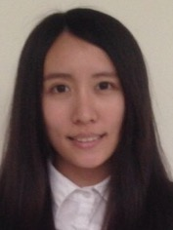
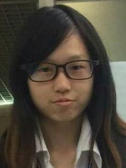
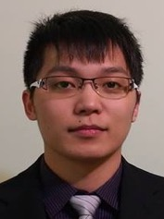
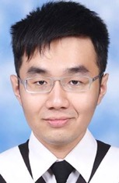
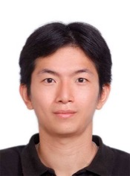
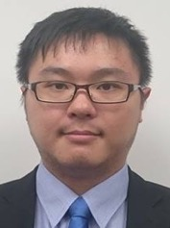
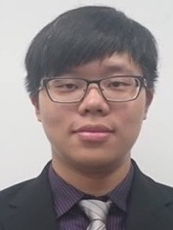
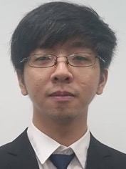
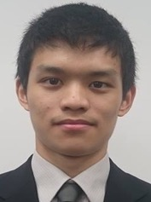
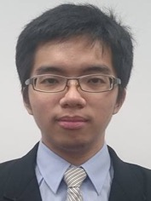
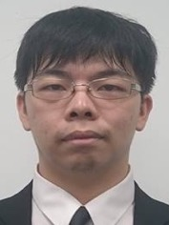
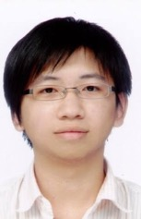
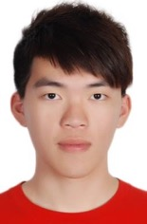
IMTKU Question Answering System for World History Exams at NTCIR-12 QA Lab2
2016
Tamkang University
Department of Information Management
Tamkang University, Taiwan
Sagacity Technology
Min-Yuh Day
Cheng-Chia Tsai
Wei-Chun Chung
Hsiu-Yuan Chang
Tzu-Jui Sun
Yuan-Jie Tsai
Jin-Kun Lin
Cheng-Hung Lee
Yu-Ming Guo
Yue-Da Lin
Wei-Ming Chen
Yun-Da Tsai
Cheng-Jhih Han
Yi-Jing Lin
Yi-Heng Chiang
Ching-Yuan Chien
myday@mail.tku.edu.tw
NTCIR-12 Conference, June 7-10, 2016, Tokyo, Japan

Slide 18
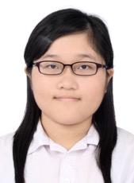
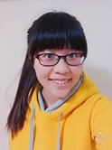
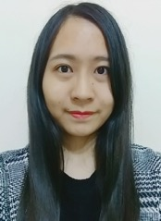
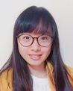
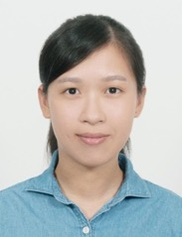
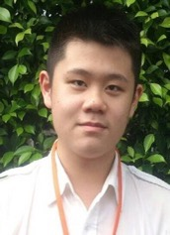


IMTKU Question Answering System for World History Exams at NTCIR-13 QALab-3
2017
Tamkang University
Department of Information Management
Tamkang University, Taiwan
Min-Yuh Day
Chao-Yu Chen
Wanchu Huang
Shi-Ya Zheng
I-Hsuan Huang
Tz-Rung Chen
Min-Chun Kuo
Yue-Da Lin
Yi-Jing Lin
myday@mail.tku.edu.tw
NTCIR-13 Conference, December 5-8, 2017, Tokyo, Japan

Slide 19
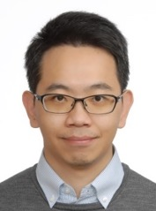
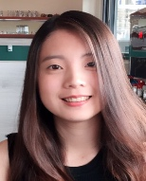
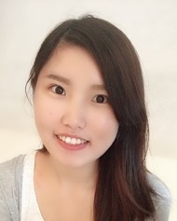
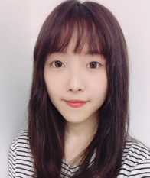
IMTKU Emotional Dialogue System for Short Text Conversation at NTCIR-14 STC-3 (CECG) Task
2019
Tamkang University
Department of Information Management
Tamkang University, Taiwan
Min-Yuh Day
Chi-Sheng Hung
Yi-Jun Xie
Jhih-Yi Chen
Yu-Ling Kuo
Jian-Ting Lin
myday@mail.tku.edu.tw
NTCIR-14 Conference, June 10-13, 2019, Tokyo, Japan

Slide 20
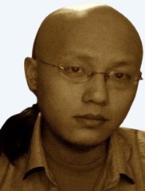
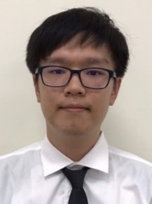
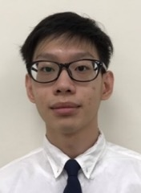
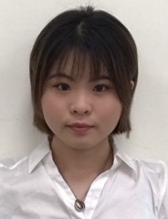
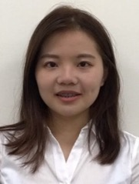
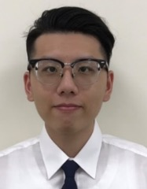
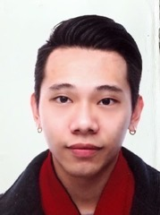

IMTKU Multi-Turn Dialogue System Evaluation at the NTCIR-15 DialEval-1 Dialogue Quality and Nugget Detection
2020
Tamkang University
¹ Zeals Co., Ltd. Tokyo, Japan
² Information Management, Tamkang University, Taiwan
³ Information Management, National Taipei University, Taiwan
Mike Tian-Jian Jiang¹
Zhao-Xian Gu²
Cheng-Jhe Chiang²
Yueh-Chia Wu²
Yu-Chen Huang²
Cheng-Han Chiu²
Sheng-Ru Shaw²
Min-Yuh Day³
NTCIR-15 Conference, December 8-11, 2020, Tokyo, Japan

Slide 21








2022
IMNTPU at the NTCIR-16 FinNum-3 Task: Data Augmentation for Financial Numclaim Classification
¹ Information Management, National Taipei University, New Taipei City, Taiwan
² Zeals Co., Ltd. Tokyo, Japan
Yung-Wei Teng ¹
Pei-Tz Chiu ¹
Ting-Yun Hsiao ¹
Mike Tian-Jian Jiang ²
Min-Yuh Day ^{1,*}
myday@gm.ntpu.edu.tw

Slide 22
2022
IMNTPU Dialogue System Evaluation
at the NTCIR-16 DialEval-2
Dialogue Quality and Nugget Detection
¹ Information Management, National Taipei University, New Taipei City, Taiwan
² Zeals Co., Ltd. Tokyo, Japan
Ting-Yun Hsiao ¹
Yung-Wei Teng ¹
Pei-Tz Chiu ¹
Mike Tian-Jian Jiang ²
Min-Yuh Day ^{1,*}
myday@gm.ntpu.edu.tw

Slide 23

NTCIR-16 Best Oral Presentation Award Recipients
2022
Source: https://research.nii.ac.jp/ntcir/ntcir-16/awards.html

Slide 24

NTCIR-16 Best Poster Presentation Award Recipients
2022
Source: https://research.nii.ac.jp/ntcir/ntcir-16/awards.html

Slide 25


臺北大學 國際發光
【記者王志誠、周貞伶／新北報導】
2022年7月9日 週六 下午8:33
由臺北大學資管所戴敏育副教授領軍的「IMNTPU」跨國團隊，在第十六屆NTCIR國際資訊存取技術評估研討會上榮獲多項大獎。其中在投資者與管理者的細粒度聲明檢測的中文分析報告分項與對話系統評測（DialEval-2）的英文金塊偵測分項EnglishNuggetDetection（ND）子任務，兩項子任務皆拿下第一名的優秀成績。
國立臺北大學資管所在戴敏育副教授帶領IMNTPU跨國團隊，其成員包括資管所碩士班研究生鄧詠薇、邱沛慈與蕭婷云，以及與日本東京Zeals公司AI自然語言科學家姜天戩共同合作，參與2022 NTCIR-16研討會榮獲許多獎項，為臺北大學資管所在NTCIR研討會上，建立良好的國際聲譽。
臺北大學資管所IMNTPU團隊在投資者與管理者的細粒度聲明檢測任務（FinNUM3）中，最終在七支隊伍中脫穎而出，除了在任務中取的平均效能為所有隊伍中最佳榮獲第一名，還囊括多項大獎，包含「口頭報告獎」與「海報展示獎」。不僅在FinNUM3口頭報告中以優秀的國際簡報與問答獲得主辦單位的高度賞識與重視；在海報展示期間，以精美海報展示與生動活潑的解說，吸引大批與會人員前來駐足交流與提問，獲得超高人氣。
戴敏育表示，希望藉由此次在國際研討會的優良成果，鼓勵學生積極參與相關國際競賽，讓學生能與國際接軌。IMNTPU隊長鄧詠薇認為，整個NTCIR-16比賽從拿到資料集、模型建置到最後預測結果，花了近半年的時間，突破重重關卡，到最後甚至能順利的在研討會中發表，這一過程受益良多。從主辦方提供的專業財務分析報告資料集，進一步針對聲明內容作細粒度分析，判斷聲明內容中的數字是否為其中重要資訊，以利相關利益者更能了解數字對於專業財務報告的重要性。
副隊長邱沛慈更談到，能夠在NTCIR-16 FinNUM中文財務分析報告中獲得第一名的績效，除了團隊共同努力外，也非常感謝戴老師與姜天戩博士在過程中給予很多建議與幫助。「經過約半年的努力，IMNTPU團隊在NTCIR-16 Dial-Eval-2對話系統評測任務英文金塊偵測分項能獲得第一名，真的很高興。」副隊長蕭婷云認為，從參與國際資訊競賽的過程中，可學習到許多寶貴經驗。
校方表示，在此次競賽中，透過與來自世界各國的高手較量，展現北大資管所的研究成果，不僅能開闊國際視野，也同時能讓世界各國看到臺灣隊伍的實力。
Source: https://tw.news.yahoo.com/%E8%87%BA%E5%8C%97%E5%A4%A7%E5%AD%B8-%E5%9C%8B%E9%9A%9B%E7%99%BC%E5%85%89-123346251.html

Slide 26
2022
IMNTPU Dialogue System Evaluation
at the NTCIR-16 DialEval-2
Dialogue Quality and Nugget Detection
¹ Information Management, National Taipei University, New Taipei City, Taiwan
² Zeals Co., Ltd. Tokyo, Japan
Ting-Yun Hsiao ¹
Yung-Wei Teng ¹
Pei-Tz Chiu ¹
Mike Tian-Jian Jiang ²
Min-Yuh Day ^{1,*}
myday@gm.ntpu.edu.tw

Slide 27



Highlights
IMNTPU ( Information Management at National TaiPei University ) Dialogue System Evaluation at the NTCIR-16 DialEval-2 Dialogue Quality (DQ) and Nugget Detection (ND).
IMNTPU submitted one run for Chinese DQ, English DQ and English ND.

Slide 28
IMNTPU Research Architecture for
NTCIR-16 DialEval-2
Pre-trained Model
XLM-RoBERTa
Tokenization Tricks
Fine-tuning Techniques
Discriminative Fine-tuning
One-cycle Policy
Optimization

Slide 29
IMNTPU Research Architecture for
NTCIR-16 DialEval-2
XLM-RoBERTa
Retains subword token letter cases
Integrates and improves approaches from Cross-lingual Language Model (XLM) pretraining schemes
Tokenize with unigram-level sentence piece
Conneau et al. (2019)
Dynamical MLM
Input text
XLM
Unigram

Slide 30
Tokenization Tricks
BOS (beginning of sentence)
SEP (separator of sentences)
xxlen 3 <s> xxtrn 1 xxsdr customer Since there is no lunar calendar in the phone's calendar, I installed a new calendar application, but the date displayed is different. @Smartisan Customer Service </s> </s> xxtrn 2 xxsdr helpdesk Hello, the problem of not displaying the lunar calendar in the view of the built-in calendar month will be updated in the later version. The external version of the calendar cannot display the dynamic icon at present. </s> </s> xxtrn 3 xxsdr customer I see. Thank you! </s>
EOS (end of sentence)

Slide 31
Tokenization Tricks
length
position
xxlen 3 <s> xxtrn 1 xxsdr customer Since there is no lunar calendar in the phone's calendar, I installed a new calendar application, but the date displayed is different. @Smartisan Customer Service </s> </s> xxtrn 2 xxsdr helpdesk Hello, the problem of not displaying the lunar calendar in the view of the built-in calendar month will be updated in the later version. The external version of the calendar cannot display the dynamic icon at present. </s> </s> xxtrn 3 xxsdr customer I see. Thank you! </s>

Slide 32
Tokenization Tricks
CNUG0
xxlen 3 <s> xxtrn 1 xxsdr customer Since there is no lunar calendar in the phone's calendar, I installed a new calendar application, but the date displayed is different. @Smartisan Customer Service </s> </s> xxtrn 2 xxsdr helpdesk Hello, the problem of not displaying the lunar calendar in the view of the built-in calendar month will be updated in the later version. The external version of the calendar cannot display the dynamic icon at present. </s> </s> xxtrn 3 xxsdr customer I see. Thank you! </s>

Slide 33
Fine-tuning Techniques
Fine-tuning Techniques
Discriminative Fine-tuning
One-cycle Policy
Optimization

Slide 34
Fine-tuning Techniques
1
Discriminative Fine-tuning
Different layers capture different types of information. They should be fine-tuned to different extents.
The initial layers capture the most general form of information.
General information of language are common and would require the least changes in their weights.
The amount of fine-tuning required increases gradually as we move towards the last layer.

Slide 35

Fine-tuning Techniques
2
One-cycle Policy
Slanted triangular learning rates
Intuition for adapting parameters to task-specific features.
The model should converge quickly to a suitable region and then refine its paramaters.
Howard & Ruder (2018)

Slide 36
Results of IMNTPU at NTCIR-16 DialEval-2 Chinese Dialogue Quality
NTCIR-16 DialEval-2 Chinese Dialogue Quality (DQ) Test set
 | A-score |  | S-score |  | E-score
Model | RSNOD | NMD | RSNOD | NMD | RSNOD | NMD
IMNTPU-run0 | 0.2479 | 0.1618 | 0.2032 | 0.1315 | 0.1860 | 0.1427
Baseline-run0 | 0.2301 | 0.1772 | 0.1998 | 0.1523 | 0.1854 | 0.1579
NTCIR-16 DialEval-2 Chinese Dialogue Quality (DQ) Development set
 | A-score |  | S-score |  | E-score
Model | RSNOD | NMD | RSNOD | NMD | RSNOD | NMD
IMNTPU-run0 | 0.2262 | 0.1495 | 0.2076 | 0.1344 | 0.1694 | 0.1251

Slide 37
Results of IMNTPU at NTCIR-16 DialEval-2 English Dialogue Quality
NTCIR-16 DialEval-2 English Dialogue Quality (DQ) Test set
 | A-score |  | S-score |  | E-score
Model | RSNOD | NMD | RSNOD | NMD | RSNOD | NMD
IMNTPU-run0 | 0.2535 | 0.1654 | 0.2020 | 0.1312 | 0.1826 | 0.1400
Baseline-run0 | 0.2321 | 0.1780 | 0.1986 | 0.1467 | 0.1745 | 0.1431
NTCIR-16 DialEval-2 English Dialogue Quality (DQ) Development set
 | A-score |  | S-score |  | E-score
Model | RSNOD | NMD | RSNOD | NMD | RSNOD | NMD
IMNTPU-run0 | 0.2102 | 0.1397 | 0.1879 | 0.1216 | 0.1617 | 0.1184

Slide 38
Results of IMNTPU at NTCIR-16 DialEval-2 Chinese Nugget Detection
NTCIR-16 DialEval-2 Chinese Nugget Detection (ND) Test set
Model | JSD | RNSS
Baseline-run0 | 0.0585 | 0.1651
NTCIR-16 DialEval-2 Chinese Nugget Detection (ND) Development set
Model | JSD | RNSS
IMNTPU-run0 | 2.0670 | 1.3969

Slide 39
Results of IMNTPU at NTCIR-16 DialEval-2 English Nugget Detection
NTCIR-16 DialEval-2 English Nugget Detection (ND) Test set
Model | JSD | RNSS
IMNTPU-run0 | 0.0601 | 0.1574
Baseline-run0 | 0.0625 | 0.1722
NTCIR-16 DialEval-2 English Nugget Detection (ND) Development set
Model | JSD | RNSS
IMNTPU-run0 | 0.0752 | 0.1727

Slide 40
Conclusion
We employed XLM-RoBERTa to extract texts between conversations to learn key information and to cope with text categorization challenges in the DQ and ND subtasks.

Slide 41
Contribution
The important contribution of this study is that we proposed two critical elements, namely, Tokenization procedures and Fine-Tuning Approaches, to improve the DQ and ND subtasks in dialogue analysis.

Slide 42
2022
IMNTPU at the NTCIR-16 FinNum-3 Task: Data Augmentation for Financial Numclaim Classification
¹ Information Management, National Taipei University, New Taipei City, Taiwan
² Zeals Co., Ltd. Tokyo, Japan
Yung-Wei Teng ¹
Pei-Tz Chiu ¹
Ting-Yun Hsiao ¹
Mike Tian-Jian Jiang ²
Min-Yuh Day ^{1,*}
myday@gm.ntpu.edu.tw

Slide 43

Highlights
IMNTPU
(Information Management at National Taipei University)
at the NTCIR-16 FinNum-3 Task: Data Augmentation for Financial Numclaim Classification
IMNTPU Submitted Three runs for NTCIR-16 FinNUM3
IMNTPU1- XLMRoBERTa Baseline Model
IMNTPU2- Double Redaction
IMNTPU3- Translation
Notes:
The Following is the highlight of our research
Due to the Imbalanced data, we assume that data augmentation will help to reduce the imbalaced situation
Therefore, we focus on our data augmentation method
Our team Submitted Three runs for FinNUM3 in Chiense dataset, and 2 runs in English

Slide 44
IMNTPU Research Architecture for NTCIR-16 FinNum-3
Data Augmentation
Double Redaction
in IMNTPU-2
Translation
in IMNTPU-3
Fined-tuning
Baseline in IMNTPU-1
Pre-trained Model
XLM-RoBERTa
Notes:
This is our research Architecture, including our baseline model which is without data augmentation technique, and the other two runs with data augmentation

Slide 45
Proposed Method
IMNTPU1 - We adopted XLM-RoBERTa Model without data augmentation as our baseline model.
IMNTPU2 - We adopt Double Redaction approach for data augmentation in XLM-RoBERTa Model.
IMNTPU3 - We adopt Translation approach for data augmentation in XLM-RoBERTa Model.

Slide 46
Fine-tuning of XLM-RoBERTa for IMNTPU at FinNum-3
Combine :
cross-lingual language model (XLM)
Tokenizer : add Special Token
Optimizer : Lamb Optimizer
Learning Rate : One-Cycle Policy
FinNum-3
Special Token
Pre-trained Model
XLM-RoBERTa
Fine
Tuning
One-cycle Policy
Lamb Optimizer
NTCIR-16 Conference, June 14-17, 2022, Tokyo, Japan
Notes:
In IMNTPU1 , we use XLMRoberta which combines and appleied Cross lingual language model as our pretrained model.
In order to optimize the model, w adjust its hyperparameters as the follows, First, in tokenization tricks we add the special token in front of the target numbers. Then we use one cycle policy to find out the optimize learning rate per cycle. Finally, we adopt a small batch size and lamb optimizer to fine tune our model.

Slide 47
Input:
Good day and welcome to the Apple Inc. Third Quarter Fiscal Year 2018 Earnings Conference Call. Today's call is being recorded.
XLM-RoBERTa Tokenizer
Output:
<s> Good day and welcome to the Apple Inc. Third Quarter Fiscal Year xxnum 2018 Earnings Conference Call. Today's call is being recorded. </s>
NTCIR-16 Conference, June 14-17, 2022, Tokyo, Japan

Slide 48

IMNTPU2- Double Redaction
NTCIR-16 Conference, June 14-17, 2022, Tokyo, Japan
Notes:
In IMNTPU2- we adopt the double redaction, you can see the process in the following pseudo code.
First we multiply the input sentence at the ratio of the imbalanced label distribution, which will be 4 times in our task
After that, We shuffle the input sentence after the tokenization and put them in the token set, Then we delete the duplicated tokens in the token set with the preservation of the special tokens.
Finally, we randomly mask the token set.

Slide 49
Double Redaction- English
Input:
Good day and welcome to the Apple Inc. Third Quarter Fiscal Year 2018 Earnings Conference Call. Today's call is being recorded.
Double Redaction for Data Augmentation
Output:
<s> <mask> day and <mask> to the Apple <mask> <mask> Quarter Fiscal Year xxnum 2018 Earnings Conference Call. Today's call is <mask> recorded. </s>
Notes:
This is an example of double redaction after tokenization in English. You can see that the special token is still preserved and we randomly mask the sentsnce.

Slide 50
Double Redaction- Chinese
Input:
巨大為全球最大自行車製造商，擁有捷安特、Liv、Momentum三個自有品牌，營收比重 70%；代工業務佔 30%，最大客戶為 TREK。主要競爭優勢在生產規模龐大，創造了成本優勢，也使其生產工藝不斷精進。品牌經營則有多面向且細膩的操作經驗，2000年和品牌顧問公司 Interbrand 合作，希望用新品牌精神：啟動探索的熱情(InspiringAdventure)連結消費者，開始各項運動行銷操作。
Double Redaction for Data Augmentation
Output:
<mask> 巨大為全球最大自行車製造商，擁有捷安特、Liv、Momentum 三個自有品牌，營收比重70%；代工業務佔 xxnum 30%，最大客戶為 TREK。主要競爭優勢在生產規模龐大，創造了成本優勢，也使其生產工藝不斷精進。品牌經營則有多面向且細膩的操作經驗，2000 年和品牌顧問公司 Interbrand 合作，希望用新品牌精神：啟動探索的熱情(InspiringAdventure)連結消費者，開始各項運動行銷操作。 </s>
NTCIR-16 Conference, June 14-17, 2022, Tokyo, Japan
Notes:
This is an example of double redaction after tokenization in Chinese

Slide 51
IMNTPU3- Translation
Traditional Chinese
English
Simplified Chinese
“The tax proceeds were $981 million, YoY+36.36 percent and EPS 2.62 percent, higher than expected. ”
“ 稅後純益 9.81 億元，YoY+36.36-%，税後 EPS2.62 元，優於預期。”
“ 税后净利润为 9.81 亿美元，YoY+36.36%，扣除 ESP 2.62 税后利润比预期的要高。”
NTCIR-16 Conference, June 14-17, 2022, Tokyo, Japan
Notes:
In IMNTPU3 for the translation approach, We adopt the translation pipeline by hugging face, we firstly translate chinese into English , and then do the backward translation to simplified Chinese. Due to the difference of language structure, there will be a slice different in some character but the meaning of the sentence sill remain the same. We use this tricks to augment our dataset

Slide 52
Performance- Chinese
Run | Dev Set F1-Score(%) | Test Set F1-Score(%)
IMNTPU-1 (Baseline) | 90.51 | 93.18
IMNTPU-2 (Double Redaction) | 88.65 | 91.64
IMNTPU-3 (Translation) | 92.16 | 91.64
NTCIR-16 Conference, June 14-17, 2022, Tokyo, Japan
Notes:
In Section 3, this is the result of our Chinese dataset, the performance of our Baseline Model is 93.18% which is the highest among all the teams

Slide 53
Performance- English
Run | Dev Set F1-Score(%) | Test Set F1-Score(%)
IMNTPU-1(Baseline) | 87.13 | 88.39
IMNTPU-2(Double Redaction) | 88.82 | 89.86
NTCIR-16 Conference, June 14-17, 2022, Tokyo, Japan
Notes:
this is the result of our English dataset, the performance of the double redaction method with data augmentation approach reaches 89.86% which is the second highest among others.

Slide 54
Conclusions
IMNTPU Submitted Three runs for NTCIR-16 FinNUM3
IMNTPU1- XLM-RoBERTa Baseline Model
IMNTPU2- Double Redaction
IMNTPU3- Transaltion
The performance with data augmentation method (Double Redaction) in English dataset is superior than without data augmentation.
NTCIR-16 Conference, June 14-17, 2022, Tokyo, Japan
Notes:
The performance with data augmentation method (Double Redaction) in English dataset is superior than without data augmentation.

Slide 55
Contribution
The major contribution of the research is that data augmentation approach may help reduce imbalanced situation.
We have developed a novel method for data augmentation technique, which is double redaction and translation approach, and can decrease the issue of imbalanced dataset.
NTCIR-16 Conference, June 14-17, 2022, Tokyo, Japan

Slide 56

2022
NTCIR-16 Best Poster Presentation Award

Slide 57
Summary
NTCIR Evaluation of Information Access Technologies
NTCIR 16 (2021-2022)
NTCIR 17 (2022-2023)
Dialogue System
Financial Technology

Slide 58
Acknowledgments: Research Projects
計畫主持人，應用 AI 技術建構加密貨幣反洗錢知識圖譜：少樣本學習模型 (Applying AI technology to construct knowledge graphs of cryptocurrency anti-money laundering: a few-shot learning model)，
科技部 (人文司 - 商事財經法)，110-2410-H-305-013-MY2，2021/08/01~2023/07/31 [核定經費 (新台幣)：1,022,000]
子計畫共同主持人，深化企業永續-由人工智慧、財務與策略觀點打造企業永續績效 (Deepen Corporate Sustainability: Enhance the Performance of Corporate Sustainability from AI, Financial, and Strategic Perspectives)：子計畫二：人工智慧企業永續評鑑與跨語言永續績效報告書生成式模型 (AI for Corporate Sustainability Assessment and Cross Language Corporate Sustainability Reports Generative Model)
國立臺北大學，111-NTPU_ORDA-F-001，2022/01/01~2022/12/31 [經費總額 (新台幣)： 3,228,500]
子計畫主持人，人工智慧方法分析企業科技創新導入- 專利文字分析與影像分析應用 (Artificial intelligence methods applied for analyzing the introduction of technological innovation: Patent text analysis and image analysis)：子計畫三：應用人工智慧於專利文本分析金融科技知識圖譜 (Artificial Intelligence for FinTech Knowledge Graph from Patent Textual Analytics)
國立臺北大學，111-NTPU_ORDA-F-003，2022/01/01~2022/12/31 [經費總額 (新台幣)： 1,291,950]
子計畫共同主持人，企業永續動機、價值攸關性與人工智慧於企業永續績效評比之應用 (Corporate Sustainability: Motivations, Value Relevance, and the Application of AI in the Assessment)：子計畫二：人工智慧 AI 於企業永續評比之應用 (An application of artificial intelligence (AI) in the corporate sustainability assessment)
國立臺北大學，110-NTPU_ORDA-F-001，2021/01/01~2021/12/31 [經費總額 (新台幣)： 3,240,000]

Slide 59
NTCIR Evaluation of Dialogue System and Financial Technology
Q & A
Host: 吳怡瑾 教授 (Prof. Nancy I-Chin Wu) Graduate Institute of Library & Information Studies, National Taiwan Normal University (NTNU)
Time: 13:30-15:30, September 16, 2022 (Friday)
Place: Graduate Institute of Library & Information Studies, NTNU
戴敏育 副教授
Min-Yuh Day, Ph.D, Associate Professor
國立臺北大學 資訊管理研究所
Institute of Information Management, National Taipei University
https://web.ntpu.edu.tw/~myday
2022-09-16

Slide 60
References
Takehiro Yamamoto and Zhicheng Dou (2022), "Overview of NTCIR-16", in Proceedings of the 16th NTCIR Conference on Evaluation of Information Access Technologies (NTCIR-16), Tokyo Japan, June 14-17, 2022.
Sijie Tao and Tetsuya Sakai (2022), "Overview of the NTCIR-16 Dialogue Evaluation (DialEval-2) Task", in Proceedings of the 16th NTCIR Conference on Evaluation of Information Access Technologies (NTCIR-16), Tokyo Japan, June 14-17, 2022.
Chung-Chi Chen, Hen-Hsen Huang, Yu-Lieh Huang, Hiroya Takamura and Hsin-Hsi Chen (2022), "Overview of the NTCIR-16 FinNum-3 Task: Investor’s and Manager’s Fine-grained Claim Detection", in Proceedings of the 16th NTCIR Conference on Evaluation of Information Access Technologies (NTCIR-16), Tokyo Japan, June 14-17, 2022.
Ting-Yun Hsiao, Yung-Wei Teng, Pei-Tz Chiu, Mike Tian-Jian Jiang, and Min-Yuh Day (2022), "IMNTPU Dialogue System Evaluation at the NTCIR-16 DialEval-2 Dialogue Quality and Nugget Detection", in Proceedings of the 16th NTCIR Conference on Evaluation of Information Access Technologies (NTCIR-16), Tokyo Japan, June 14-17, 2022.
Yung-Wei Teng, Pei-Tz Chiu, Ting-Yun Hsiao, Mike Tian-Jian Jiang, and Min-Yuh Day (2022), "IMNTPU at the NTCIR-16 FinNum-3 Task: Data augmentation for financial Numclaim classification", in Proceedings of the 16th NTCIR Conference on Evaluation of Information Access Technologies (NTCIR-16), Tokyo Japan, June 14-17, 2022.

